Slide 1


Bus Topology
Group T1-D
Friday, January 24, 2020
Presented To:
Ishan Timilsina
Presenters:
/The1337s
Bikash Paswan
Hemanta Pokharel
Hemant Bhandari
Puskar Dahal

Slide 2
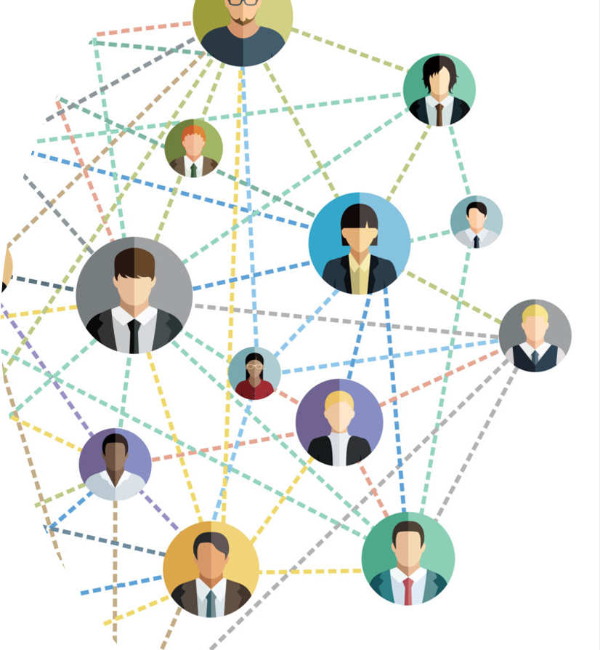
Our Today’s Topics
Network
Network Topology
1
2
Its Types
Bus Topology
3
4
Its Advantages
Disadvantages
5
6

Slide 3



Network
A network is a collection of computers, servers, mainframes, network devices, peripherals, or other devices connected to one another to allow the sharing of data.
Local Area Network
Metropolitan Area Network
Wide Area Network
Phone, Computer and TV connected to a single network (Home Network) via cables, Wi-Fi, Bluetooth Etc.
Cable TV network, Telephone networks Etc.
Internet is the best example of Wide Area Network.

Slide 4
Network
Topology
01. Physical Topology
Network Topology is the schematic description of a network arrangement, connecting various nodes(sender and receiver) through lines of connection.
Actual layout of the computer cables.
02. Logical Topology
The way device actually communicate internally.

Slide 5
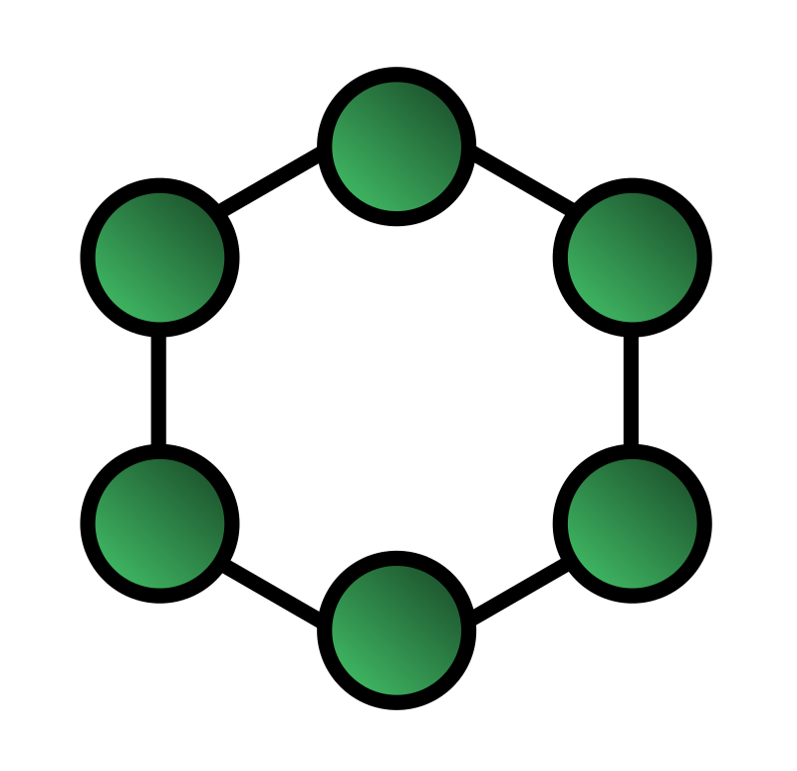

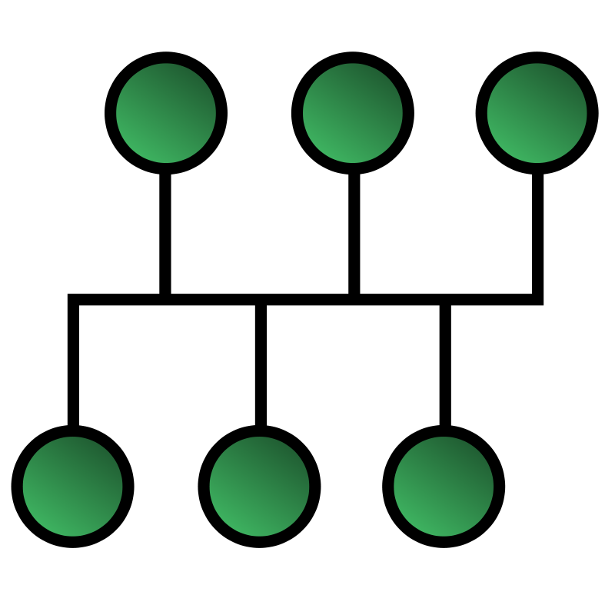
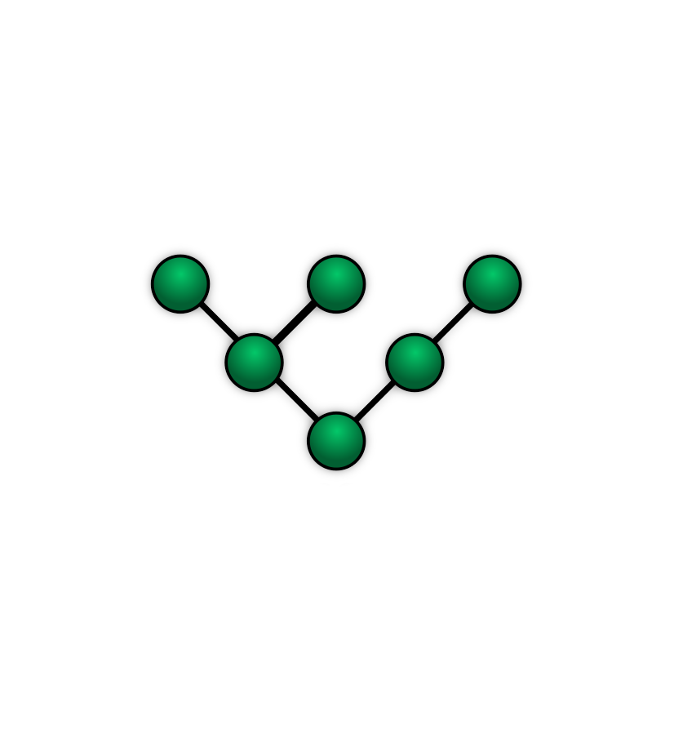
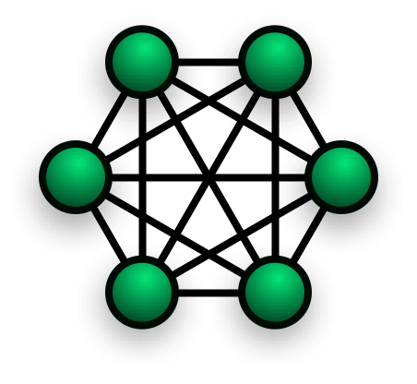
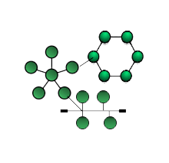
Types of Network Topology
Bus Topology
Ring Topology
Star Topology
Mesh Topology
Tree Topology
Hybrid Topology

Slide 6
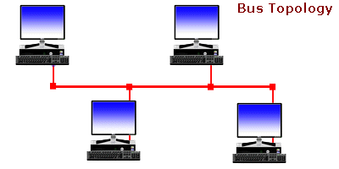
Bus Topology
A bus network is a network topology in which nodes are directly connected to a common half-duplex link called a bus.
01. Uses a trunk or backbone to which all of the computer in the network connect.
02. System connect to this backbone using T-connector.
03. Co-axial cabling were popular option year ago.

Slide 7

Advantages
Some of the advantages of Bus Topology are:
Very easy to connect a computer or peripheral to a linear bus
Requires less cable length than a star topology resulting in lower costs
1
2
The linear architecture is very simple and reliable
It does not need a dedicated device and It works well for small networks
3
4
It is easy to extend by joining cable with connector or repeater
If one node fails, it will not affect the whole network
5
6

Slide 8




Disadvantages
Some of the disadvantages of Bus Topology are:
The entire network shuts down if there is a break in the main cable or one of the T connectors break
01
02
Large amount of packet collisions on the network, which results in high amounts of packet loss
All node get the info and this is slow with many nodes in the network
03
04
There is a security issue and It is difficult to isolate any faults on the Network

Slide 9


THANKS
Have a nice day !

